Slide 1
ONLINE Notice Board SYSTEM

Slide 2
INDEX
Introduction
Objectives
Software requirements
Architecture
Future work
conclusion

Slide 3
INTRODUCTION
Communication is an issue in every society, by this problems in communication is partially solved since you don’t have to print posters to stick to a wall notice board, and people can view your posts without necessarily visiting the wall notice board. The system will contain notice boards managed by leaders of the organisation. A person will not have to visit a wall notice board in order to know the latest posts or any post he/she is interested in. The system will manage all the posts sent to the online notice board

Slide 4
Objectives
-Make the system a distributed system accessible to many devices
-Use web development to implement the system
-Create a user friendly system
-Add Pop up Capabilities to System.

Slide 5
Software Requirements
-Front End
HTML
CSS
Java Script
Ajax
-Middle layer
PHP
-Back End
MYSQL
-Lamp Server

Slide 6
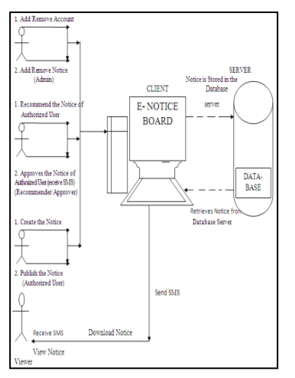
Architecture
send notification
Receive Notice

Slide 7
PROPOSED SYSTEM
-As of now we limited the system to one organisation and to the users of same organisation
-take a university and students as example
-of course mailing is working but we may not open our mails every time
-and technically also we are just making this as web application.

Slide 8
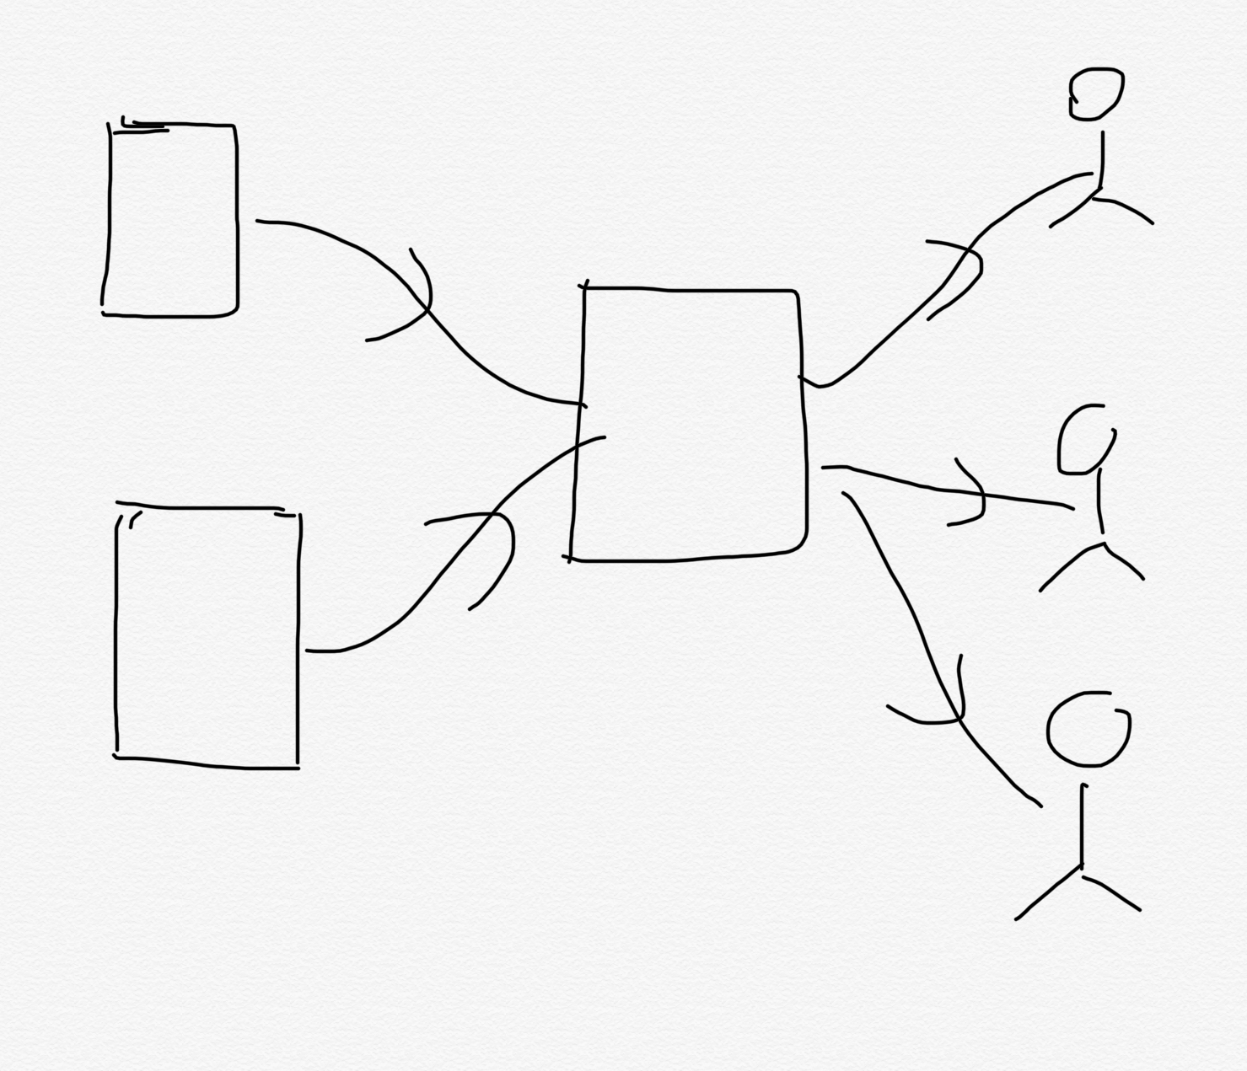
Future Work
-Many Organisations and to many users

Slide 9
ADVANTAGES OF ONLINE EXAMINATION
- It is not required to going at College Notice Board see Information regarding to any event or advertise or a messages.
- The College easily posts all types of message on the notice board.
- Students can easily go through the notices through their logins.
-Secure because of authentication.
-Easy to use
-Reliable and accurate
-users can view at any time After the posting the notice any time

Slide 10
CONCLUSION
The online Notification system is a web application and the main aim is to reduce the paper and time for users and increase the digital form. And the information can obtain very accurate and users can view the notices on time.

Slide 11


